Slide 1
TCU Best Practices
Leech Lake Tribal College/Stone Child College
Prepared for AIHEC 40th Anniversary Conference
August 8-10, 2013
By Dr. Sharon Marcotte and Dr. Kadene Drummer

Slide 2
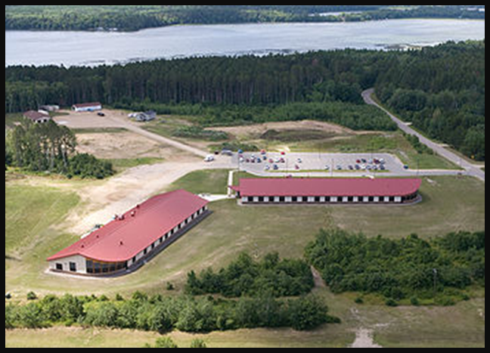
TCU Best Practices
Leech Lake Tribal College
Stone Child College

Slide 3
Project Highlights for Stone Child College
Art Rainingbird Learning Center
Mid-term Advising and Mid-term Madness
Monday Drum
Newsletter – The Flush
Increased student engagement activities

Slide 4
LLTC Partnership Highlights
Learning Center
Monday Drum—Instilled cultural tradition
Walmart Student Success Grant
PASS Committee

Slide 5
Nando-Gikenjige Wigamig Learning Center
The ability to establish a Learning Center, hire a full-time director, and provide stipends for carefully selected peer tutors has yielded incredible benefits for the College.
Effective study skills and time management.
Connection for Path to Success course
Extra academic help for challenging classes.
People who support your educational goals.
Quality academic advising and counseling.
A place to belong.
Policy in place to sustain LC when personnel change

Slide 6
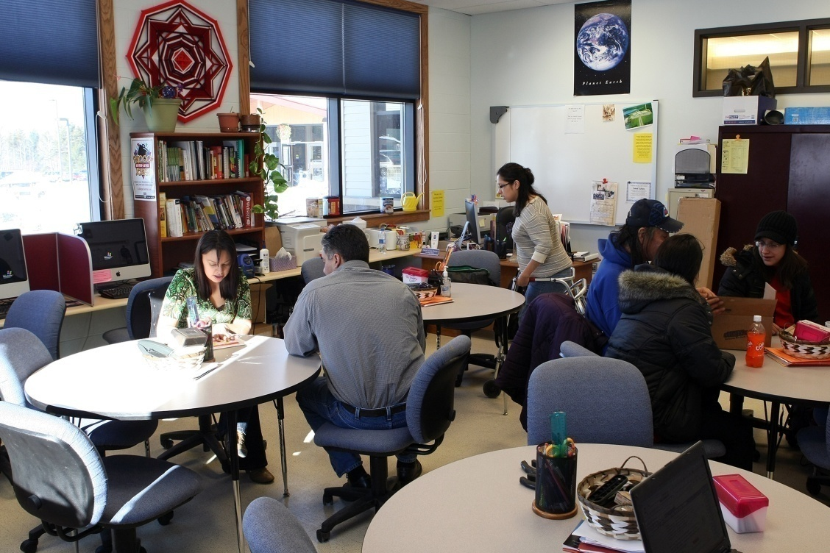
Nando-Gikenjige Wigamig Learning Center
Notes:
Funded by a grant initially designed to raise intellectual capital in Indian Country. Grant proposed to raise student retention rates in math and English classes. Years 2004-2007 had a dismal 15 % of students passing English 101 and equally divided among failures and withdraws. Students talk about their experiences of being successful at LLTC as opposed to their other school experiences.

Slide 7
Learning Center
The most significant impact, in fact, has been (and continues to be) the transformative effect our peer tutoring program has had on LLTC’s entire constituency.
Because tutees feel more comfortable with their peers, they tend to grasp difficult subject matter more quickly, and they often form friendships that provide them with the encouragement and informal counseling needed to persist in their studies
Policy in place to ensure tutors are properly trained.
Tutor Manuel
Mandatory weekly meetings
Data collected on student’s subject needs.

Slide 8
Learning Center Visitors

Slide 9
Art Rainingbird Learning Center
Student centered.
Faculty involvement – at least one hour per week as posted on the schedule.
Tutors available – procedure in place for tutors to collect starting and final grade of class for assessment purposes.
Full-time director in center every day, all day.

Slide 10
Art Rainingbird Learning Center – cont.
Data collected on what student is doing in learning center, how long they spend, etc.
Textbooks available for many classes.
Computers available with access to printing.

Slide 11
Mid-term Advising
Data analysis indicated students were more likely to complete their courses if they engaged outside the classroom with other students and faculty.

Slide 12
Mid-term Advising cont.
Based on the data and after a trial run, Stone Child College implemented mandatory Mid-Term Advising. Quickly the strategy grew into advising in the morning and competitions in the afternoon which is aptly named, Midterm Madness, and enjoyed by students, faculty and staff.

Slide 13
Mid-term Advising cont.
For the past three semesters, students and faculty overwhelmingly agree that Mid-term Advising and Mid-term Madness increased the likelihood of students completing their semester courses.

Slide 14
Mid-term Advising Spring 2013 Data – 90 student surveys collected
93% of survey participants think that mid-term advising helps them be successful in completing their credits.
90% said they would spend more time on campus if there were more similar events like Mid-term Madness

Slide 15
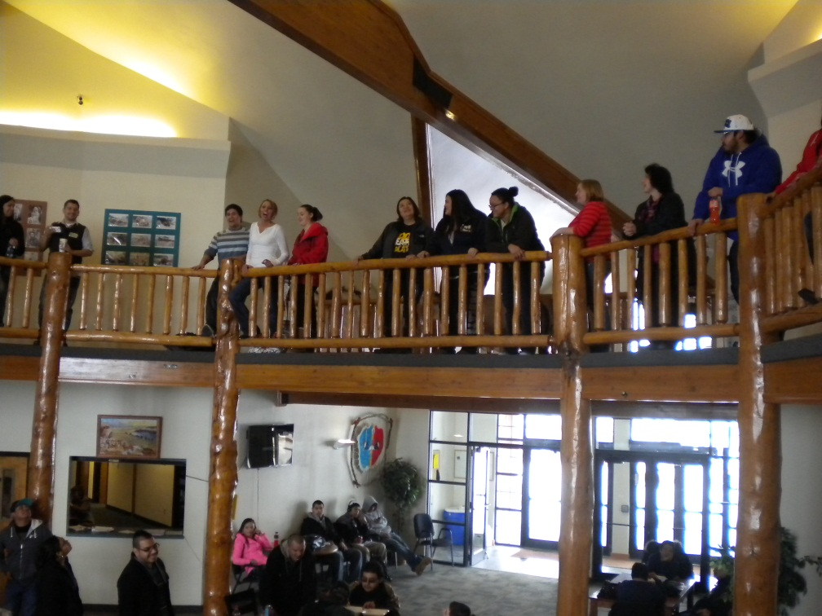
Sample of Using the Data
51% reported having a “C” or below in at least one class, 72% reported their advisor discussed strategies to improve their grades and 80% reported being willing to implement at least one of these strategies. Finally, 48% stated they were interested in joining a study group, yet faculty data showed that only 36% of advisees were given the recommendation to join a study group.
Through data analysis, faculty at SCC are piloting a project to add a requirement to some syllabi stating required time in study groups or tutoring if a student is a “C” or below in a class. This project is set to begin Fall 2014.

Slide 16
Monday Drum Instilled Cultural Tradition
History
We were looking for a way to come together each week in a spiritual manner as community. We were too separated as family, all following our own paths.
Began as a morning drum—not well attended.
2003 moved to Monday Lunch with simple soup and sandwich.
Notes:
LLTC actually had a Monday morning drum (but no meal accompanying it) from the inception of the College, I believe; however, it was scheduled at 8 a.m., and as I recall, there were only a couple of drummers when I joined the College in 2001--Willie St. Cyr and Bennie Tonce. As a new employee, I thought I should be there, but I quickly learned that the drum was not well attended (4 or 5 people, at most), and I was often the only woman present. In 2003, when Leah became Interim President, she asked faculty to contribute whatever they could to a Monday meal for students, and until we moved to the new campus, we simply had a drum song and prayer, followed by soup & sandwiches. Once we moved to the new campus, the meals became much larger, and we used both the science classroom and the ECE classroom for seating. When Cedar Hall opened in 2006, we began using the Benny Tonce Room (which wasn't named until after Benny's death in 2009), and the Monday Drum/Potluck has continued as it is today.

Slide 17
Leech Lake Tribal College Monday Drum Today
A place for Ceremony, announcements and food.
All staff and faculty are on a team which provides, menu, buys the food, and prepares the food.
Once a month the administration budget buys the food.

Slide 18
Stone Child College Monday Drum
Student drum group performs a drum song.
Learning Center Director and others give announcements.
Faculty and staff put together teams to prepare and serve lunch to 80-100 people with 60-70 of those being students.

Slide 19
Monday Drum cont.
Data is analyzed and used to determine effectiveness each semester.
Student comment: “Providing weekly lunches and letting us know what is going on really helps me stay in school.”

Slide 20
Monday Drum Leads to Newsletter
From this weekly strategy of information sharing using a cultural approach, an additional strategy, shared by Sitting Bull College at our first mentor/mentee whole collaboration meeting, an informational newsletter called the “FLUSH” is created and posted in the bathrooms to reinforce the sharing of information so that all students know what is going on, but also get involved in weekly opportunities

Slide 21
LLTC Pass Committee
Progressive Academic Student Success
Walmart Grant raised awareness of need to examine policy.
SAP Policy—data showed students entering on Academic probation were not getting their needs met.
Bridging Student Services and Academics
Better communication to faculty advisors

Slide 22
PASS Committee
Interdepartmental Committee
Student Services
Faculty
Academics
Learning Center
Financial Aid
Registrar
department chair
Responsibilities
SAP Appeals
Policy discussions
Catalog
Retention Strategies
Course sequencing
Jump Start
Early Alert
Better communication
Duties as assigned

Slide 23
Increased Student Engagement
This branching off from the main mentor-mentee sharing of ideas and into learning from the whole collaboration has exponentially given Stone Child College the opportunity to explore numerous possibilities to increase student retention.

Slide 24
Increased Student Engagement cont.
Due to the success of Monday Drum, student surveys, and current literature (How College Affects Students, Pascarella & Terenzini, 2005, p. 602), Stone Child College continues to increase student engagement in their continuing effort to increase student retention.

Slide 25
Working Together for Student Success
This collaboration has given us the opportunity to increase student retention through strategies that have proven to be effective.

